Slide 1
应用系统体系架构 人工智能模块
A.4 课 循环神经网络
From: http://colah.github.io/posts/2015-08-Understanding-LSTMs/
colah's blog: Understanding LSTM Networks

Slide 2
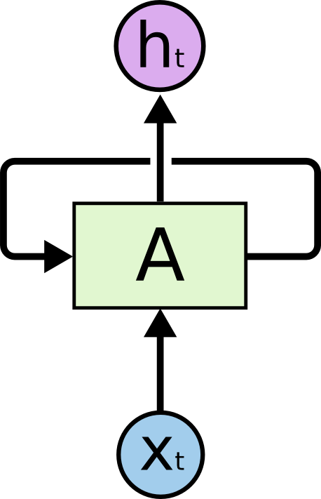
Recurrent Neural Networks
Humans don’t start their thinking from scratch every second.
As you read this essay, you understand each word based on your understanding of previous words.
You don’t throw everything away and start thinking from scratch again.

Slide 3
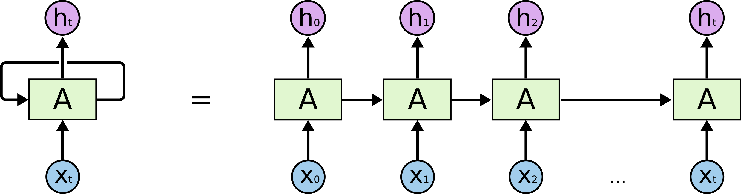
Recurrent Neural Networks
A recurrent neural network can be thought of as multiple copies of the same network, each passing a message to a successor. Consider what happens if we unroll the loop:

Slide 4
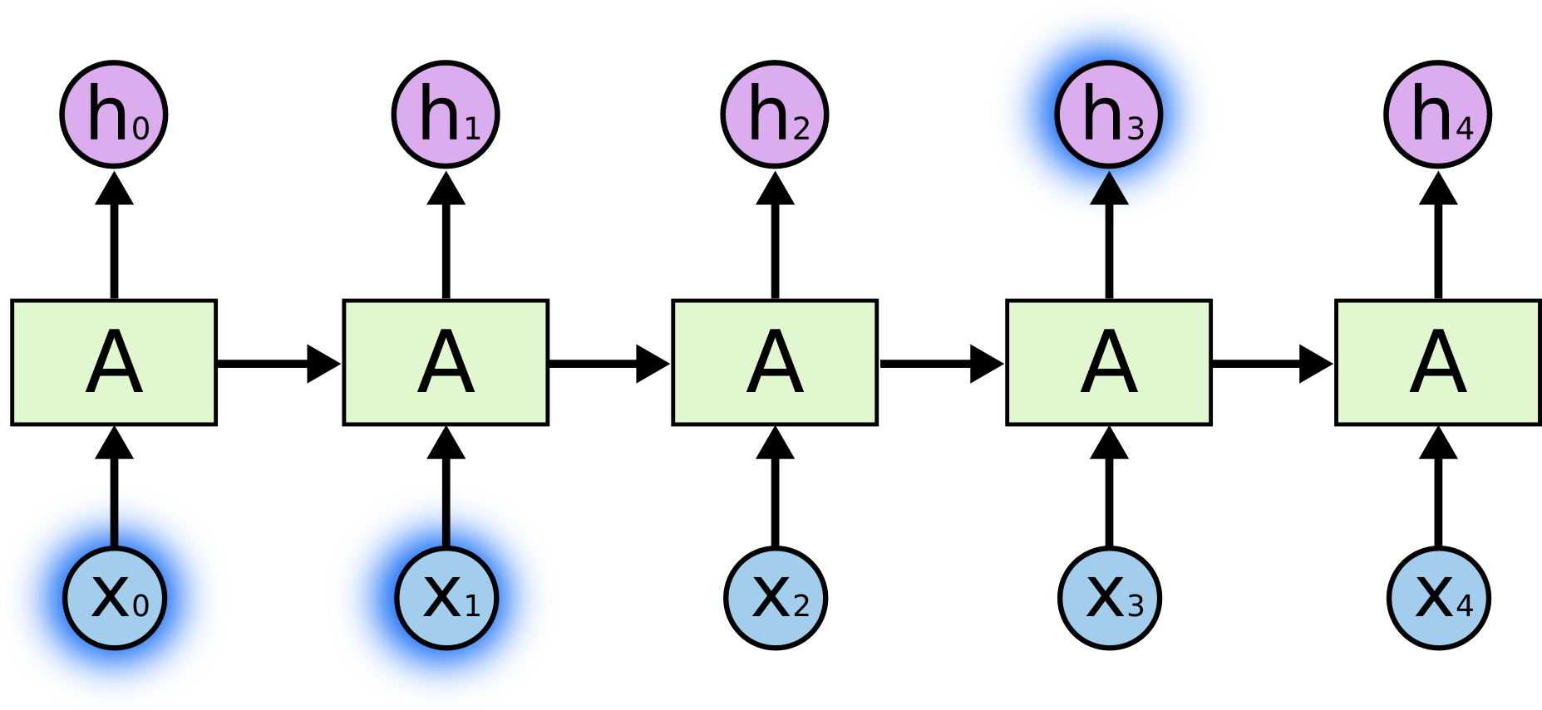
The Problem of Long-Term Dependencies
Sometimes, we only need to look at recent information to perform the present task.

Slide 5
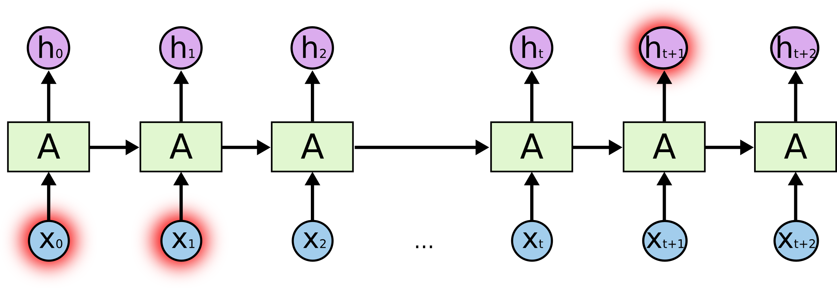
The Problem of Long-Term Dependencies
It’s entirely possible for the gap between the relevant information and the point where it is needed to become very large.

Slide 6
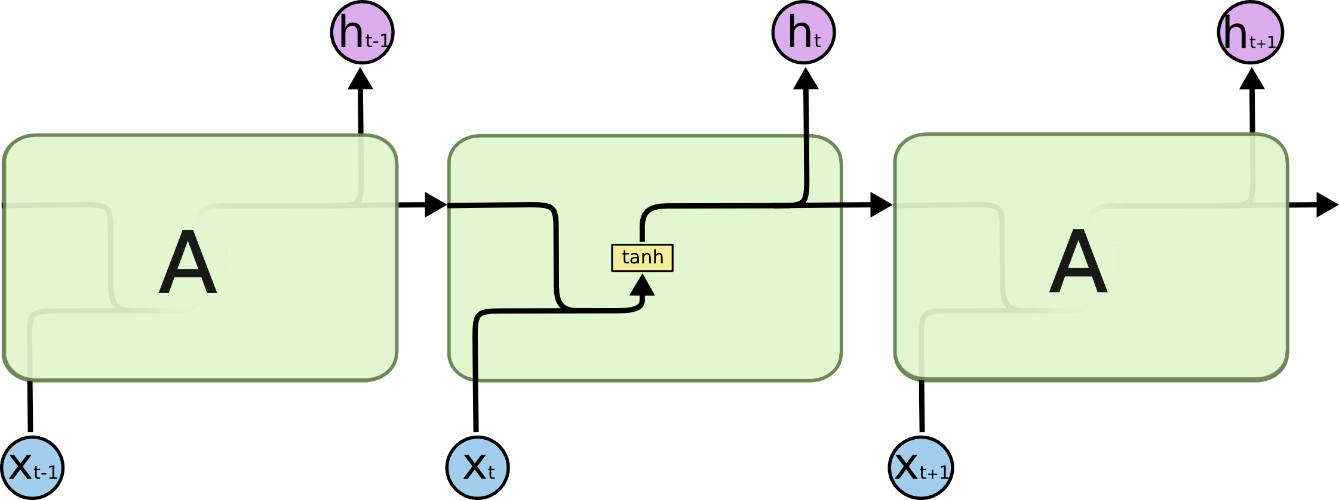
LSTM Networks
Long Short Term Memory networks – usually just called “LSTMs” – are a special kind of RNN, capable of learning long-term dependencies.
The repeating module in a standard RNN contains a single layer.

Slide 7

LSTM Networks
Long Short Term Memory networks – usually just called “LSTMs” – are a special kind of RNN, capable of learning long-term dependencies.
The repeating module in an LSTM contains four interacting layers.

Slide 8
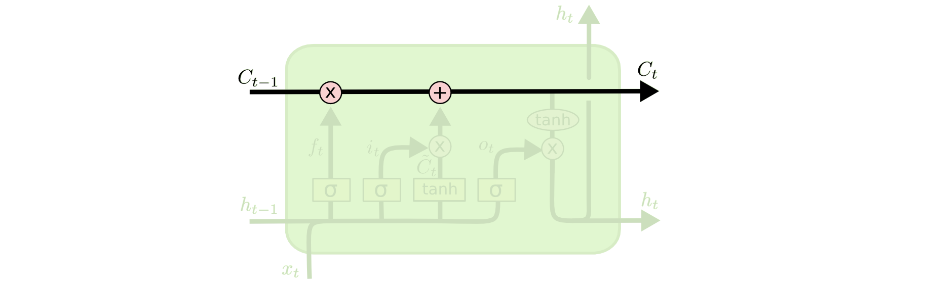
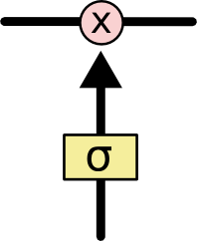
The Core Idea Behind LSTMs
The key to LSTMs is the cell state.
The cell state is kind of like a conveyor belt. It runs straight down the entire chain, with only some minor linear interactions. It’s very easy for information to just flow along it unchanged.

Slide 9
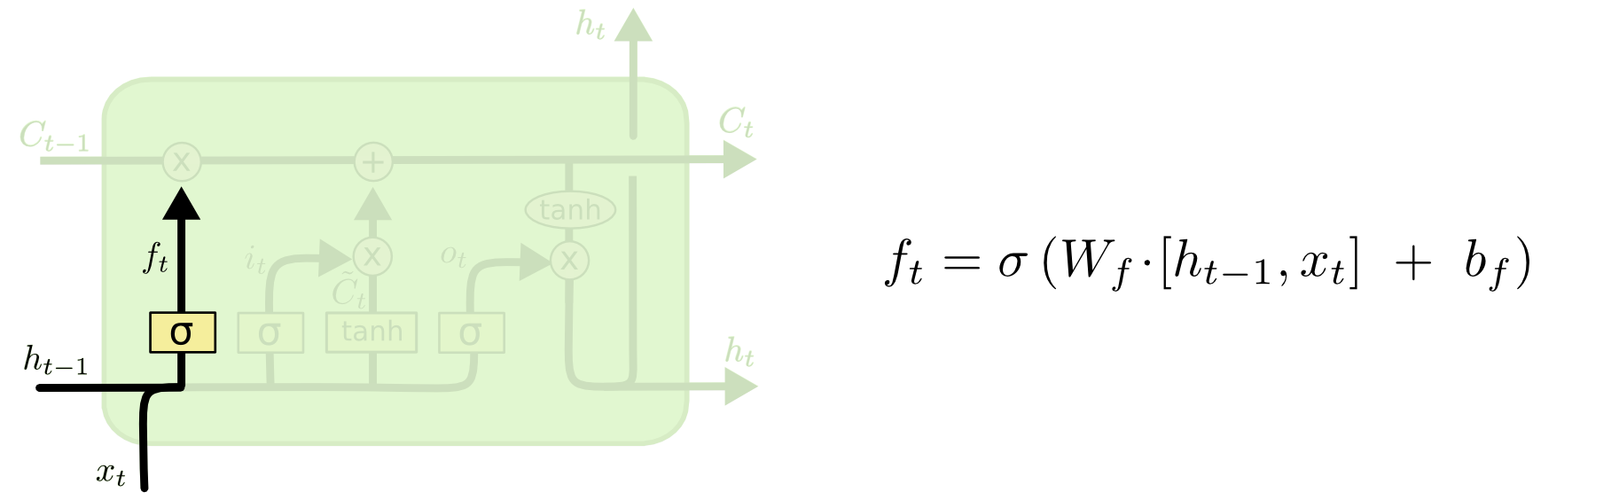
Step-by-Step LSTM Walk Through
The first step in our LSTM is to decide what information we’re going to throw away from the cell state

Slide 10
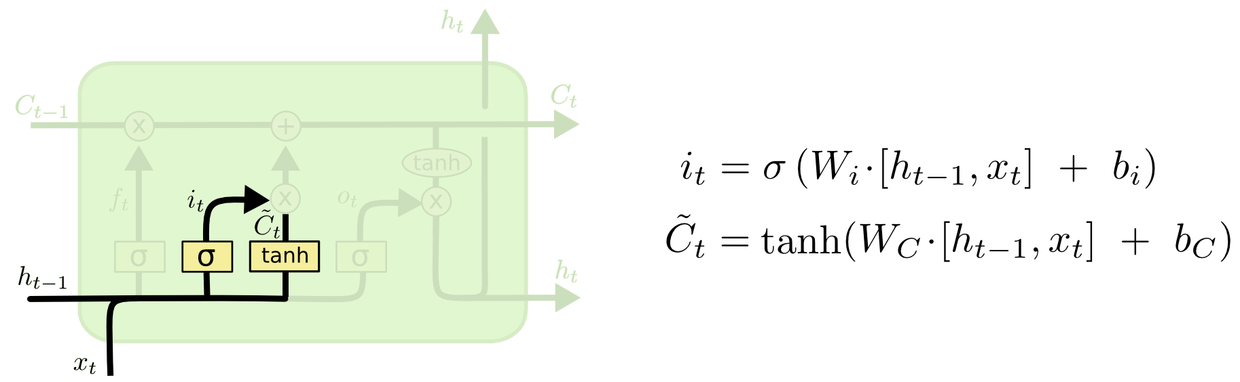
Step-by-Step LSTM Walk Through
The next step is to decide what new information we’re going to store in the cell state.

Slide 11
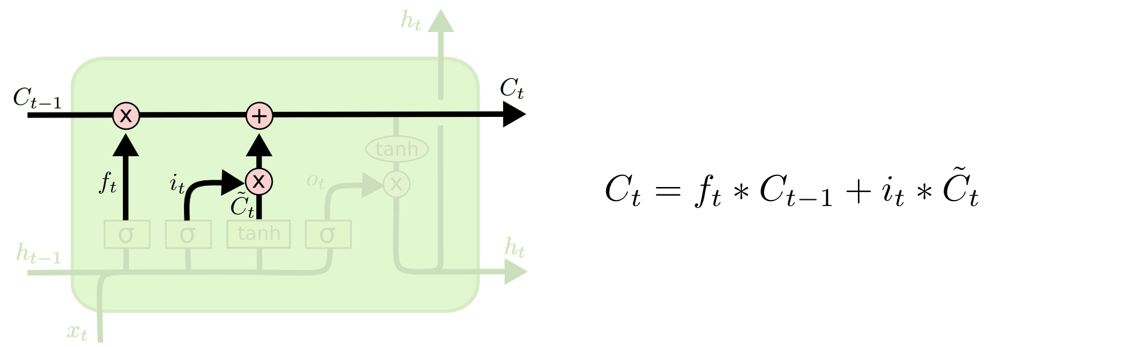
Step-by-Step LSTM Walk Through
The next step is to decide what new information we’re going to store in the cell state.

Slide 12
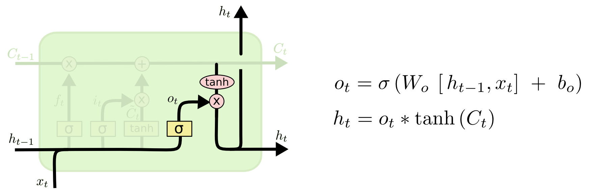
Step-by-Step LSTM Walk Through
Finally, we need to decide what we’re going to output.

Slide 13
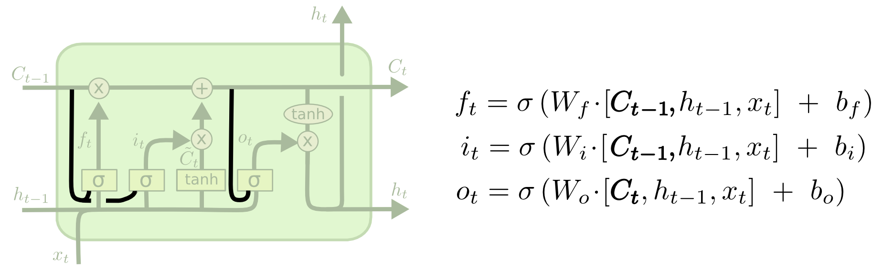
Variants on Long Short Term Memory
One popular LSTM variant, introduced by Gers & Schmidhuber (2000), is adding “peephole connections.”

Slide 14
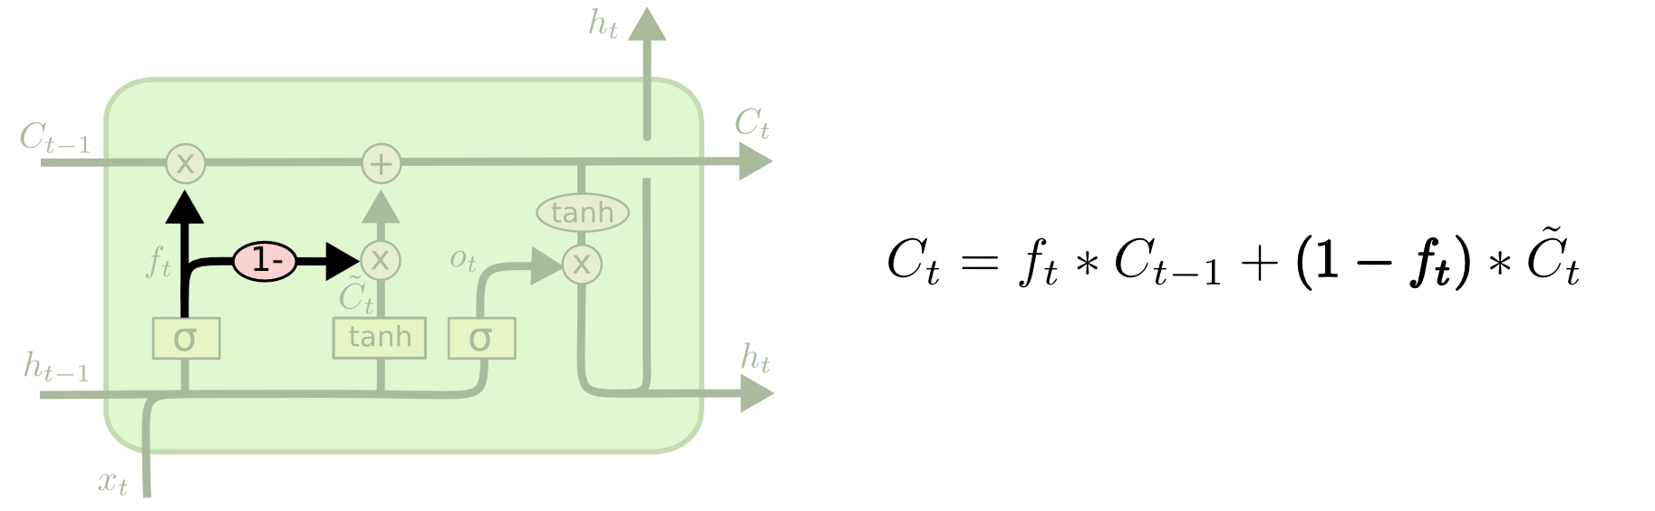
Variants on Long Short Term Memory
Another variation is to use coupled forget and input gates.

Slide 15
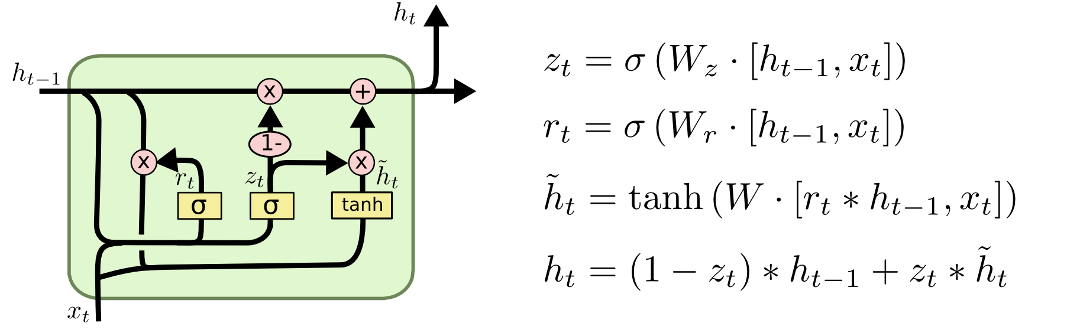
Variants on Long Short Term Memory
A slightly more dramatic variation on the LSTM is the Gated Recurrent Unit, or GRU, introduced by Cho, et al. (2014). It combines the forget and input gates into a single “update gate.”

Slide 16
未完待续
谢谢

